Slide 1


Advanced Certificate Programme
in Machine Learning, Gen AI & LLMs for Business Applications
Session 2
Large Language Models
Transformer Architecture
Dr. Ramji Srinivasan
Adjunct Professor & Senior Consultant, IIT Madras | Facilitator, IITM Pravartak & Jaro Education
Co-founder & Director, Bit2Qubit Technologies Ltd | Scientific Advisor, ParvAI Labs & Sonolight Imaging
16th August 2026

Slide 2
Course Modules
Foundations of Large Language Models
Training and Scaling LLM
Prompt Engineering
Fine-Tuning and Model Adaptation
Retrieval-Augmented Generation
AI Agents and Agentic Systems
Multimodal LLM
Productionizing AI Application

Slide 3

Execution Plan for Module 1
Module 1 Foundations of Large Language Models
DATE | PLAN
19-07-2026 (Sun) | Theory: Evolution of Language Models
16-08-2026 (Sun) | Theory: Transformers and Foundation Models Practical: Installation & Setup complete, NLP, Evolution of LLM
22-08-2026 (Sat) - CANCELLED | Practical: Explore Hugging Face Hub, Analyze Model Cards, Compare GPT-2/FLAN-T5/Llama Outputs, Experiment with Temperature/Top-K/Top-P, Prompt-Response Analysis Practical: Tokenization Experiments, BPE Token Visualization, Embedding Visualization, Attention Visualization, Comparing Encoder vs Decoder Models
23-08-2026 (Sun)
$$A=πr^{2}$$

Slide 4
Agenda
Recap of Session 1
Large Language Models
Transformer Architecture
  Tokenization
  Input Embeddings
  Positional Encodings/ Embeddings
  Encoders (Self Attention, Multi-head Attention, Add & Normalization, Feedforward Layer, Training Objective)
  Decoders (Masked Self-Attention, Next Token Prediction, Training Objective)
  Encoders-Decoders (Cross Attention, Training Objective)
Transformer Variants
  Encoder Only Models
  Decoder Only Models
  Encoder-Decoder Models
Rise of Decoder Only LLMs
Learning Highlights
Hands ON

Slide 5
Advanced Certificate Programme in Machine Learning, Gen AI & LLMs for Business Applications
Foundations of LLMs
Recap of Session 1

Slide 6
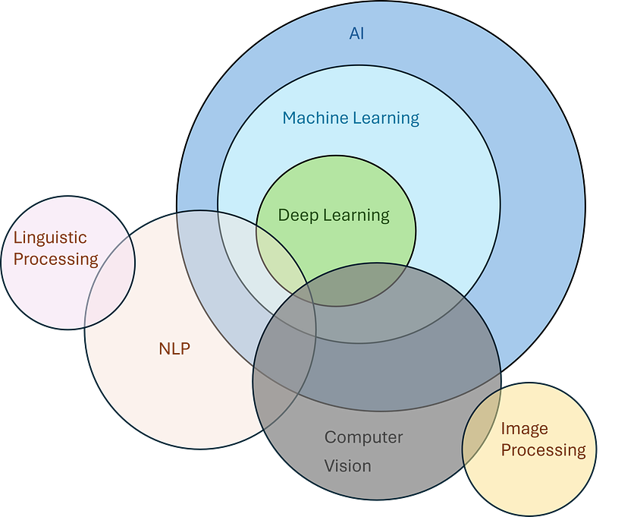
Natural Language Processing

Slide 7
NLU vs NLG
Aspect | Natural Language Understanding (NLU) | Natural Language Generation (NLG)
Definition | Enables machines to understand and interpret human language. | Enables machines to generate human-like language from structured information or internal representations.
Primary Goal | Convert language into meaning. | Convert meaning or data into language.
Input | Natural language text or speech. | Structured data, knowledge, or internal representation.
Output | Intent, entities, semantics, relationships, sentiment, etc. | Natural language sentences, paragraphs, or conversations.
Direction | Language → Meaning | Meaning/Data → Language
Key Question | "What does the user mean?" | "How should the system express this information?"
Typical Tasks | Intent detection, entity extraction, sentiment analysis, question understanding, text classification. | Text generation, summarization, report generation, dialogue response, translation, caption generation.
Focus | Comprehension and interpretation. | Expression and communication.
Core Challenge | Understanding ambiguity, context, and semantics. | Producing coherent, fluent, and contextually appropriate text.
Common Techniques (Traditional) | Rule-based systems, parsing, statistical models, classifiers. | Template-based systems, grammar rules, statistical language models.

Slide 8
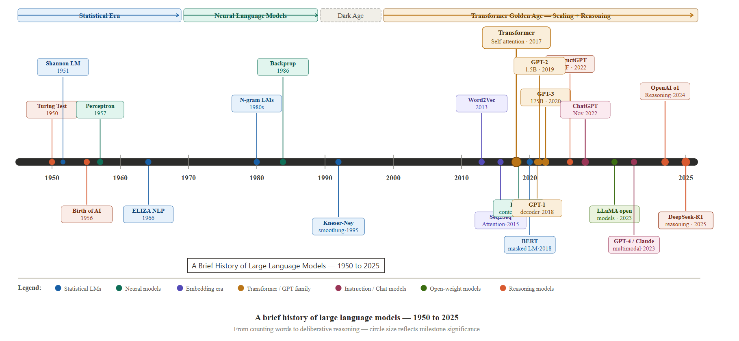
Evolution - Timelines

Slide 9
Language Model
A Language Model (LM)
  Model that learns the patterns, structure, and relationships of human language
  Model that can help predict, understand, and generate natural language.
Key Characteristics
  Learns from large text corpora.
  Captures grammar, context, and meaning.
  Estimates the likelihood of the next word or piece of text.

Slide 10
Comparison – Language Models
Model family | Core idea | Strengths | Limitations | Context handling | Typical use today
Statistical Language Models | Estimate next-word probabilities from observed word frequencies (e.g., N-grams) | Simple, interpretable, fast inference, low compute | Sparse data problem, poor generalization, no semantic understanding, fixed context | Very short (typically 2–5 previous words) | Historical systems, educational purposes, some embedded or low-resource applications
Neural Language Models (RNN, LSTM, GRU) | Learn distributed word representations and sequence patterns using recurrent neural networks | Better generalization, captures semantic relationships, handles variable-length sequences | Sequential computation limits scalability, difficult long-range dependencies, slower training | Moderate (tens to hundreds of tokens in practice) | Legacy NLP pipelines, speech recognition, time-series and sequence modeling
Large Language Models (Transformers) | Learn language using self-attention across tokens and large-scale pretraining | Strong generation, reasoning, multitask learning, transfer learning, in-context learning | High compute cost, hallucinations, alignment/safety challenges, limited interpretability | Long (thousands to millions of tokens depending on architecture) | Chatbots, copilots, RAG systems, coding assistants, search, agents, multimodal AI

Slide 11
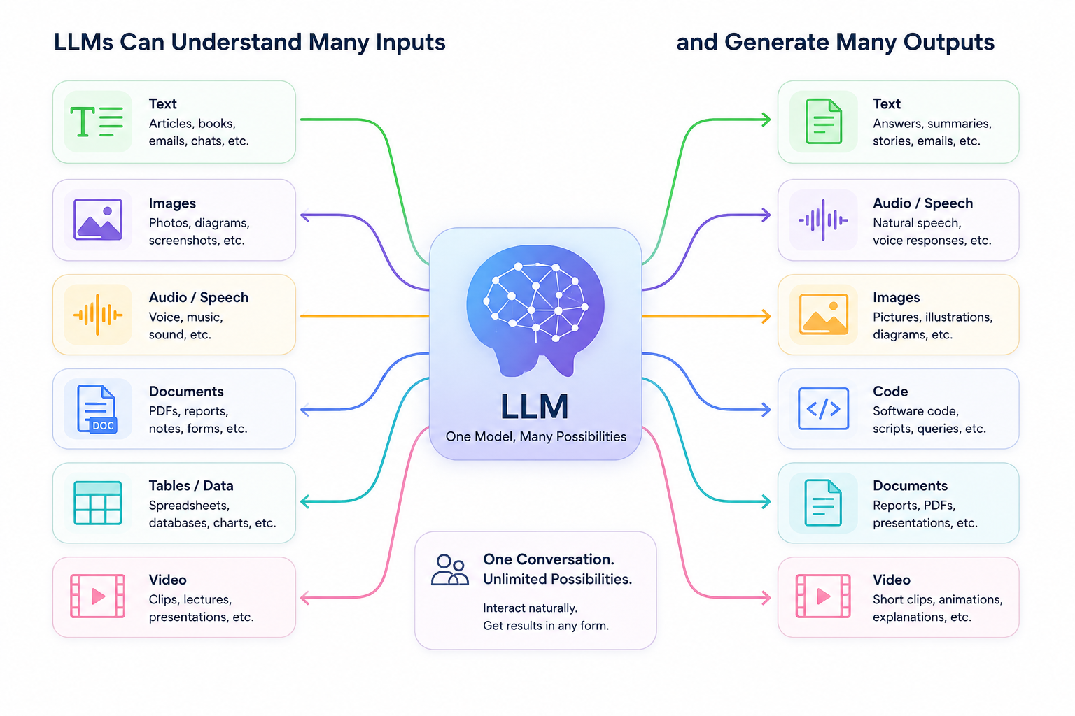
Beyond Text: Modern LLMs
Modern LLMs have evolved to understand and generate multiple types of information, including text, images, audio, documents, code, and videos

Slide 12
Advanced Certificate Programme in Machine Learning, Gen AI & LLMs for Business Applications
Foundations of LLMs
Section 2: Large Language Models

Slide 13
Large Language Models
What LLMs are ?
  Neural Language Models that can recognize, generate, translate, and summarize large amounts of text
How they work ?
  Most use transformer architectures that capture long-range context/relationships across words
What they learn/do ?
  Trained on large corpora (books, articles, web pages) to perform tasks like generation, translation, summarization, sentiment.

Slide 14
Large Language Models
What drives quality ?
  model size, diverse/high-quality data, and training algorithms impact capability and usefulness.
Cost to train ?
  requires massive compute and time; e.g., GPT-4 reportedly cost >$100M to train.
Who builds them ?
  The largest LLMs are concentrated in a few organizations with the necessary tech, talent, and capital

Slide 15
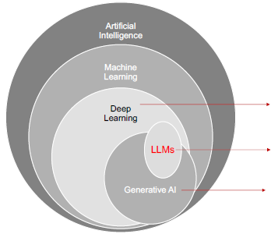
Large Language Models: AI Taxonomy
Subset of ML uses ANN to learn the data
Specific type of Gen-AI model trained with DL algorithms that focusses on generating humans-like text
Subset of AI focusses on generating new content

Slide 16
Advanced Certificate Programme in Machine Learning, Gen AI & LLMs for Business Applications
Foundations of LLMs
Section 2: Large Language Models
Transformer Architecture

Slide 17
Motivation
Traditional language models could predict the next word but struggled with complex language understanding
    E.g. John gave Peter his laptop because he had finished his work.
    E.g. I saw the man with the telescope.
RNNs and LSTMs processed text sequentially, making training slow and difficult to parallelize.
Capturing long-range dependencies became challenging as sequence length increased.
  E.g. John went to the supermarket after finishing work. He met his friend, had coffee, discussed a project, bought groceries, and then returned home. Before sleeping, he remembered that he had forgotten to buy milk.
Performance degraded when processing long documents or conversations.
Scaling to massive datasets and large models was computationally inefficient.
Modern NLP required architectures that were faster, more scalable, and context-aware.

Slide 18
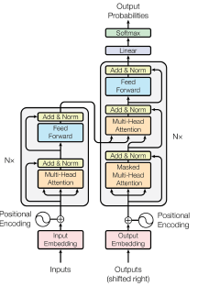
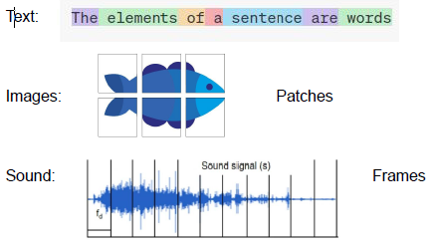
What are Transformers?
Transformers are a Neural Network Architecture that learns which parts (or elements) of a sequence (or data) should pay attention to understand the context and generate output
https://arxiv.org/abs/1706.03762

Slide 19
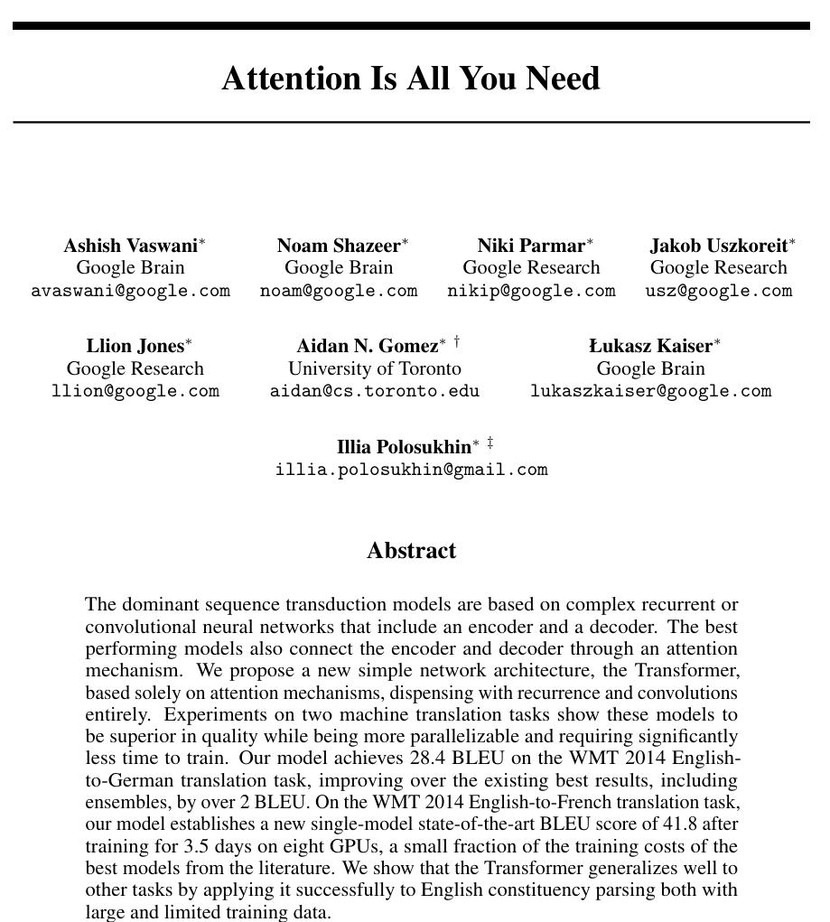

Transformer Architecture (Overview)
Introduced in "Attention Is All You Need" (2017).
Designed to process sequences using the Self-Attention mechanism.
Consists of two main components: Encoder and Decoder.
Both components are built by stacking multiple identical layers.
Forms the foundation of modern LLMs

Slide 20
What can we do with Transformers?
Natural Language Processing:
  Language Modelling, Text classification, QA, Translation, Summarization, Text generation, Named Entity Recognition etc.
Computer Vision:
  Image classification, Object detection and Segmentation
Audio:
  Automatic Speech Recognition and Audio Classification
Multimodal:
  Optical Character Recognition, Video classification, Visual QA etc.

Slide 21
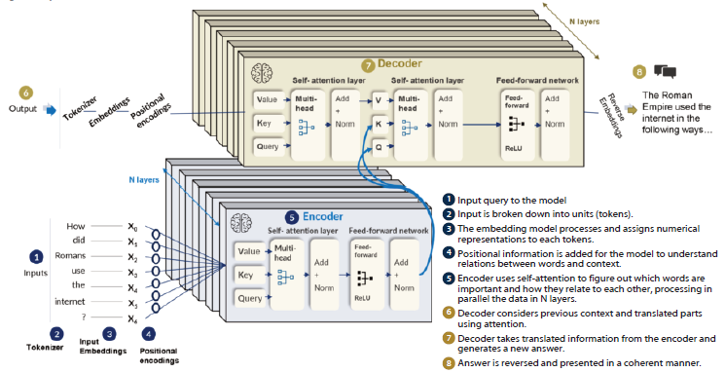
Transformer Architecture (Overview)
https://www.managementsolutions.com/sites/default/files/minisite/static/72b0015f-39c9-4a52-ba63-872c115bfbd0/llm/pdf/rise-of-llm.pdf

Slide 22
Advanced Certificate Programme in Machine Learning, Gen AI & LLMs for Business Applications
Foundations of LLMs
Section 2: Large Language Models
Transformer Architecture - Tokenization

Slide 23
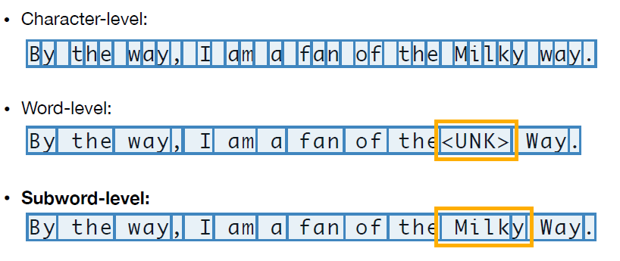
Tokenization
Converts text into smaller units called tokens.
Tokens are the fundamental units processed by LLMs.
Tokens can represent characters, subwords, words, or punctuation.
Each token is mapped to a unique ID from the model's vocabulary.
The token sequence is then used as input to the Transformer.
Text: "Transformers are amazing!“
Tokens: ["Transform", "ers", "are", "amazing", "!"]

Slide 24
Tokenization Pipeline
Normalization
  Standardize text (lowercasing, whitespace, punctuation, Unicode normalization*)
Pre-tokenization
  Split text into smaller units (words, punctuation, symbols)
Tokenization
  Convert text into tokens using a tokenization algorithm
  Character-level (e.g., Character Split)
  Word-level (e.g., Whitespace Tokenizer, Rule-based Tokenizer, Regex Tokenizer)
  Subword-level (e.g., Byte Pair Encoding (BPE), WordPiece, SentencePiece)
Vocabulary Construction
  Build a vocabulary of unique tokens
  Assign a unique numerical ID to each token
*Unicode normalization is the process of standardizing character strings so that visually and semantically identical texts have the same binary representation

Slide 25
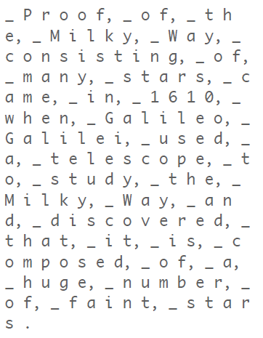
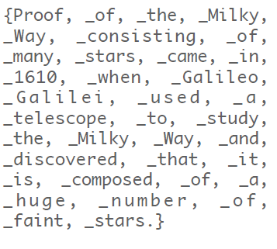
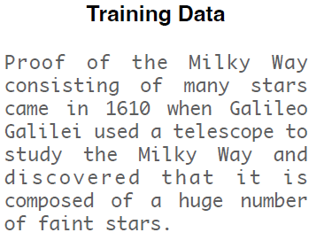
Tokenization – Byte-Pair Encoding
Universal method for learning subword tokenizers
Build vocabulary of tokens bottom-up by a merging frequent pair of tokens
Pre-tokenize: Splitting on white space
Split into sequence of bytes

Slide 26
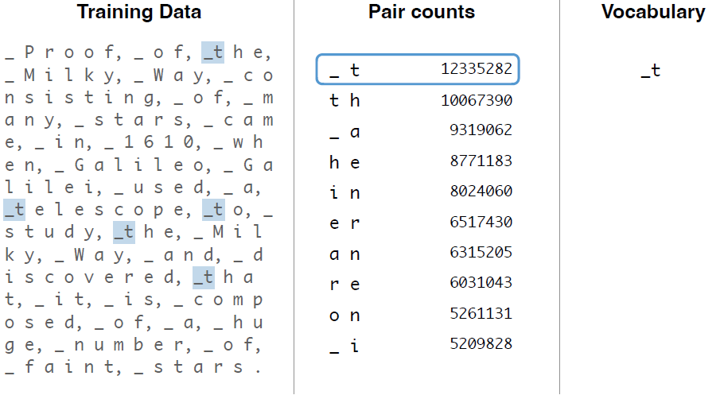
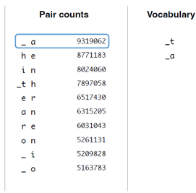
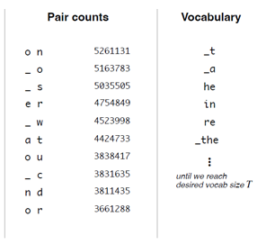
Tokenization – Byte-Pair Encoding
Universal method for learning subword tokenizers
Build vocabulary of tokens bottom-up by a merging frequent pair of tokens
https://christophergs.com/blog/understanding-llm-tokenization

Slide 27
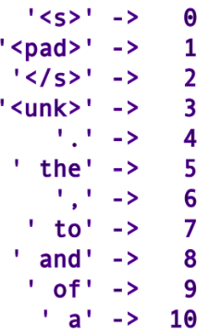
Tokenization – Byte-Pair Encoding
Building Vocabulary
  Collect unique tokens
  Assign unique numerical id for each token
Tokens
Token Ids

Slide 28
Advanced Certificate Programme in Machine Learning, Gen AI & LLMs for Business Applications
Foundations of LLMs
Section 2: Large Language Models
Transformer Architecture – Input Embeddings

Slide 29
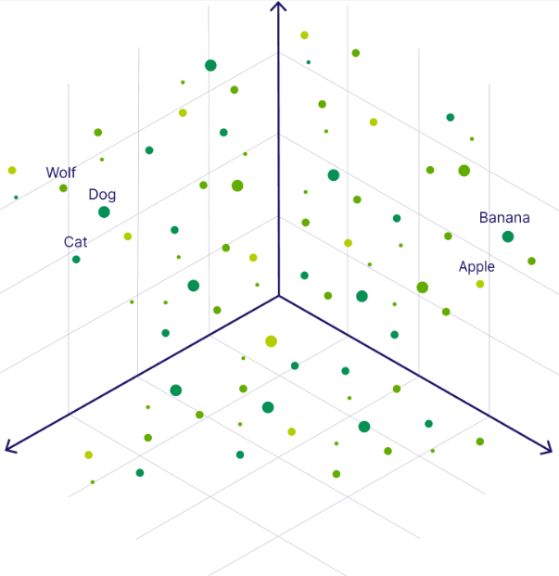
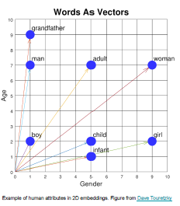
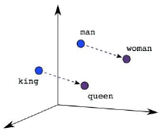
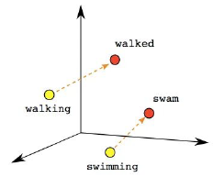
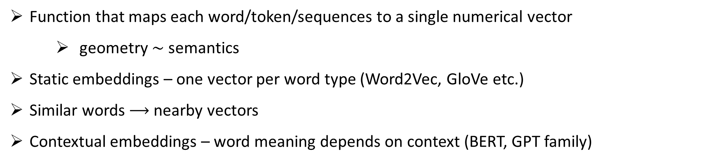
Embeddings
Function that maps each word/token/sequences to a single numerical vector
    geometry $∼$ semantics
Static embeddings – one vector per word type (Word2Vec, GloVe etc.)
Similar words $⟶$ nearby vectors
Contextual embeddings – word meaning depends on context (BERT, GPT family)

Slide 30
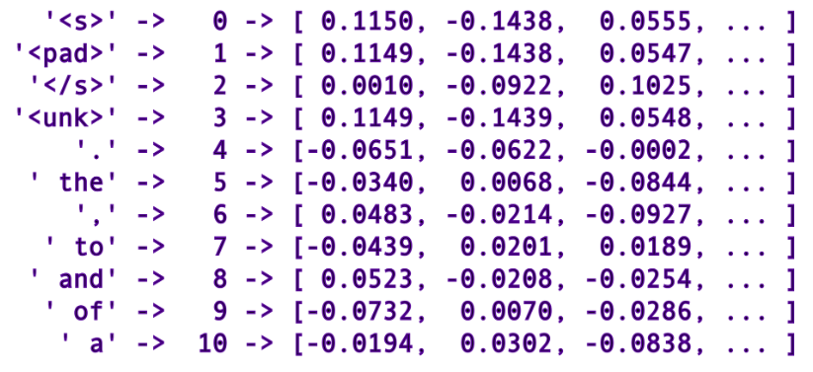
Token Embeddings
Token Embeddings:
  Map token ID to a dense vector of continuous values
  Token embeddings start as a lookup table of randomly initialized vectors
  Learned during training
Tokens
Token Ids
Token embeddings

Slide 31
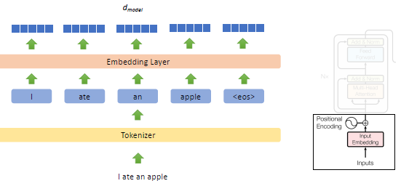
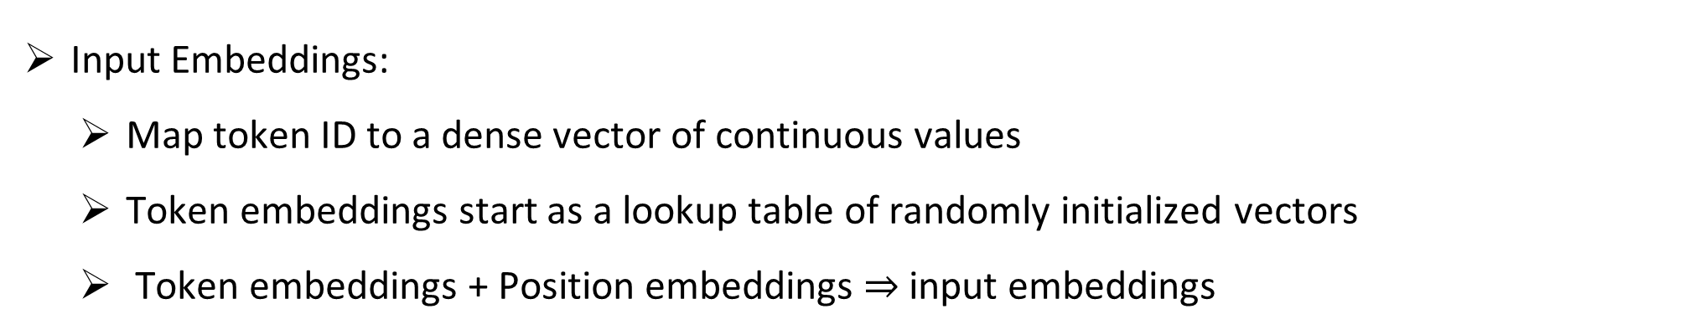
Input Embeddings
Input Embeddings:
  Map token ID to a dense vector of continuous values
  Token embeddings start as a lookup table of randomly initialized vectors
  Token embeddings + Position embeddings $⇒$ input embeddings
Input Embeddings

Slide 32
Advanced Certificate Programme in Machine Learning, Gen AI & LLMs for Business Applications
Foundations of LLMs
Section 2: Large Language Models
Transformer Architecture – Positional Encodings/Embeddings

Slide 33
Need for Positional Embeddings
Token embeddings represent what a word means, but not where it appears.
Word order is essential for understanding the meaning of a sentence.
Positional information is required to identify each token's location in the sequence.
Such additional information would enable the model to learn word order, sentence structure.

Slide 34
Generating Position Encodings
Each token is assigned a unique positional encoding based on its position.
Positional encodings have the same dimensionality as the token embeddings.
The original Transformer generates positional encodings using sinusoidal functions.
Sine and cosine functions are used to create a unique encoding for each position.
  Different frequencies allow the model to capture both short-range and long-range positional relationships.
The generated positional encoding is added to the corresponding token embedding.

Slide 35
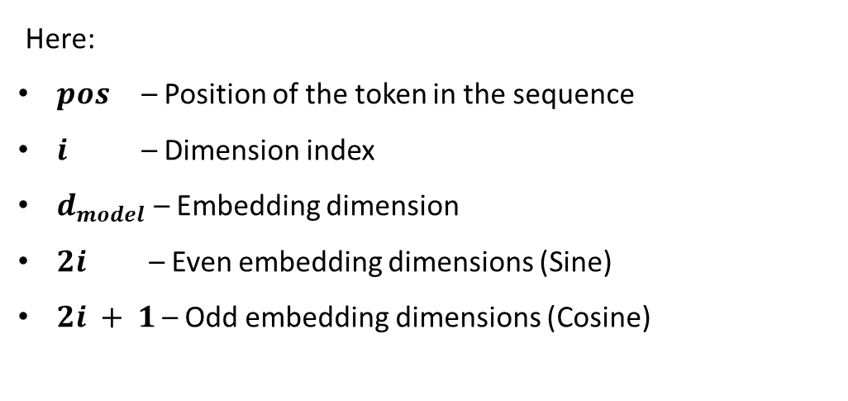
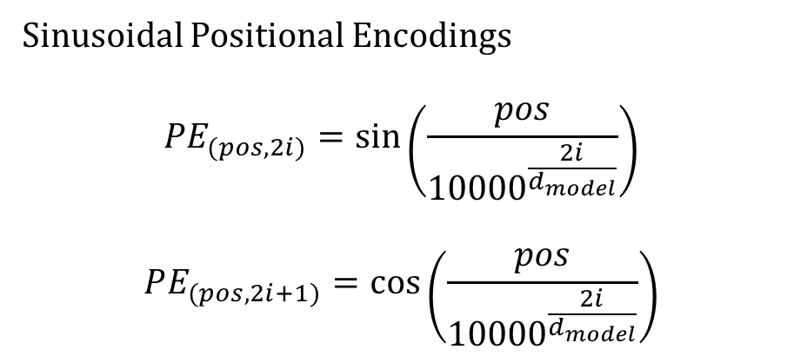
Sinusoidal Position Encodings
Sinusoidal Positional Encodings
$$PE_{(pos, 2i)}=\sin\left(\frac{pos}{{10000}^{\frac{2i}{d_{model}}}}\right)$$
$$PE_{(pos, 2i+1)}=\cos\left(\frac{pos}{{10000}^{\frac{2i}{d_{model}}}}\right)$$
Why Sine and Cosine?
Produce a unique encoding for every position.
Preserve relative distances between token positions.
Capture positional information at multiple scales (frequencies).
Generalize to sequences longer than those seen during training.
Here:
$pos$ – Position of the token in the sequence
$i$ – Dimension index
$d_{model}$– Embedding dimension
$2i$ – Even embedding dimensions (Sine)
$2i + 1$– Odd embedding dimensions (Cosine)

Slide 36
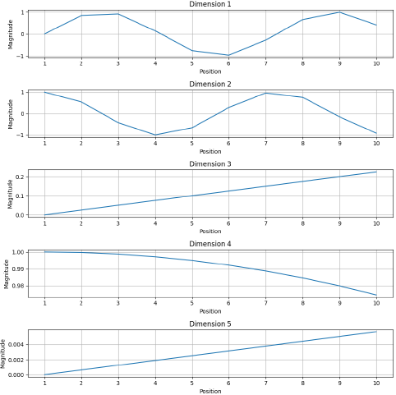
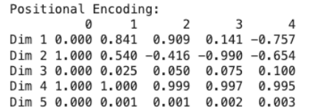
Sinusoidal Position Encodings

Slide 37



Generating SPE - EXAMPLE
1 Suppose we have the sentence:
"I love AI"
4
"I love AI"
Position (0) – ‘I’
$$[sin\left(0\right),\cos\left(0\right),\sin\left(0\right),cos⁡(0)]$$
[0.000, 1.000, 0.000, 1.000]
Token | Position
I | 0
love | 1
AI | 2
Position (1) – ‘Love’
$$[sin\left(1\right),\cos\left(1\right),\sin\left(0.01\right),cos⁡(0.01)]$$
2 Lets, assume the embedding dimension is 4
[0.841, 0.540, 0.010, 0.999]
3 For d = 4 (Applying those formula), we would have:
Dimension | Function
0 | sin(position)
1 | cos(position)
2 | sin(position / 100)
3 | cos(position / 100)
Position (2) – ‘AI’
$$[sin\left(2\right),\cos\left(2\right),\sin\left(0.02\right),cos⁡(0.02)]$$
[0.909, -0.416, 0.020, 0.999]

Slide 38
Generating SPE - EXAMPLE
The resulting Positional Encoding Matrix
Position | Dim 0 | Dim 1 | Dim 2 | Dim 3
0 | 0.000 | 1.000 | 0.000 | 1.000
1 | 0.841 | 0.540 | 0.010 | 0.999
2 | 0.909 | -0.416 | 0.020 | 0.999

Slide 39
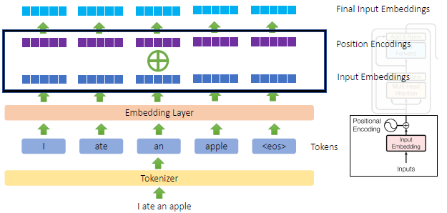
Resultant Input Embeddings
Input Embeddings:
  Token embeddings + Position embeddings

Slide 40
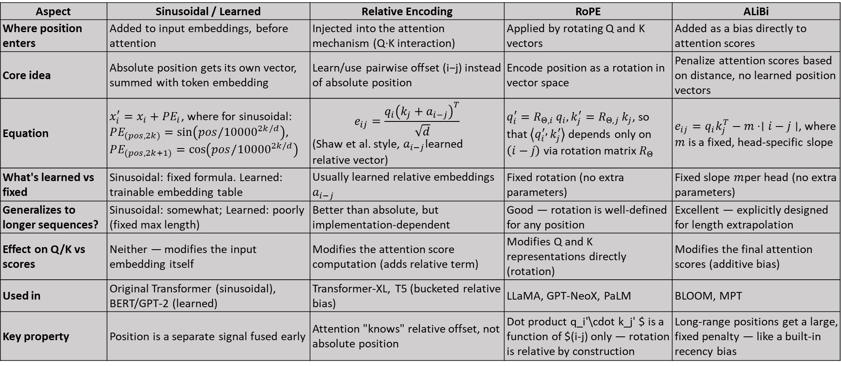
Positional Embeddings Variants
Aspect | Sinusoidal / Learned | Relative Encoding | RoPE | ALiBi
Where position enters | Added to input embeddings, before attention | Injected into the attention mechanism (Q·K interaction) | Applied by rotating Q and K vectors | Added as a bias directly to attention scores
Core idea | Absolute position gets its own vector, summed with token embedding | Learn/use pairwise offset (i−j) instead of absolute position | Encode position as a rotation in vector space | Penalize attention scores based on distance, no learned position vectors
Equation | $x_{i}^{′}=x_{i}+PE_{i}$, where for sinusoidal: $PE_{(pos, 2k)}=sin⁡\left(pos/{10000}^{2k/d}\right)$, $PE_{(pos, 2k+1)}=cos⁡\left(pos/{10000}^{2k/d}\right)$ | $$e_{ij}=\frac{q_{i}{\left(k_{j}+a_{i−j}\right)}^{T}}{\sqrt{d}}$$ (Shaw et al. style, $a_{i−j}$learned relative vector) | $q_{i}^{′}=R_{Θ,i} q_{i}, k_{j}^{′}=R_{Θ,j} k_{j}$, so that $\left\langle q_{i}^{′} , k_{j}^{′}\right\rangle$ depends only on $\left(i−j\right)$ via rotation matrix $R_{Θ}$ | $e_{ij}=q_{i}k_{j}^{T}−m⋅∣i−j∣$, where $m$ is a fixed, head-specific slope
What's learned vs fixed | Sinusoidal: fixed formula. Learned: trainable embedding table | Usually learned relative embeddings $a_{i−j}$ | Fixed rotation (no extra parameters) | Fixed slope $m$per head (no extra parameters)
Generalizes to longer sequences? | Sinusoidal: somewhat; Learned: poorly (fixed max length) | Better than absolute, but implementation-dependent | Good — rotation is well-defined for any position | Excellent — explicitly designed for length extrapolation
Effect on Q/K vs scores | Neither — modifies the input embedding itself | Modifies the attention score computation (adds relative term) | Modifies Q and K representations directly (rotation) | Modifies the final attention scores (additive bias)
Used in | Original Transformer (sinusoidal), BERT/GPT-2 (learned) | Transformer-XL, T5 (bucketed relative bias) | LLaMA, GPT-NeoX, PaLM | BLOOM, MPT
Key property | Position is a separate signal fused early | Attention "knows" relative offset, not absolute position | Dot product q_i'\cdot k_j' $ is a function of $(i-j) only — rotation is relative by construction | Long-range positions get a large, fixed penalty — like a built-in recency bias

Slide 41

Thank you
Reach to me: ramji@iitm.ac.in

